Slide 1

Software Maintenance
&
Quality Assurance
TTTE6104
Software Engineering Paradigm

Slide 2
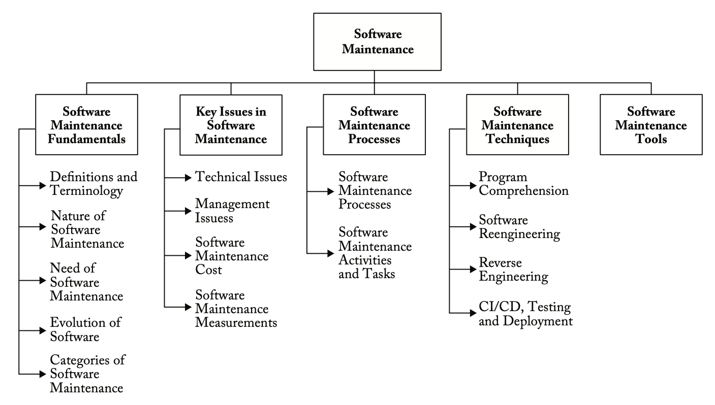
Breakdown of Topic

Slide 3
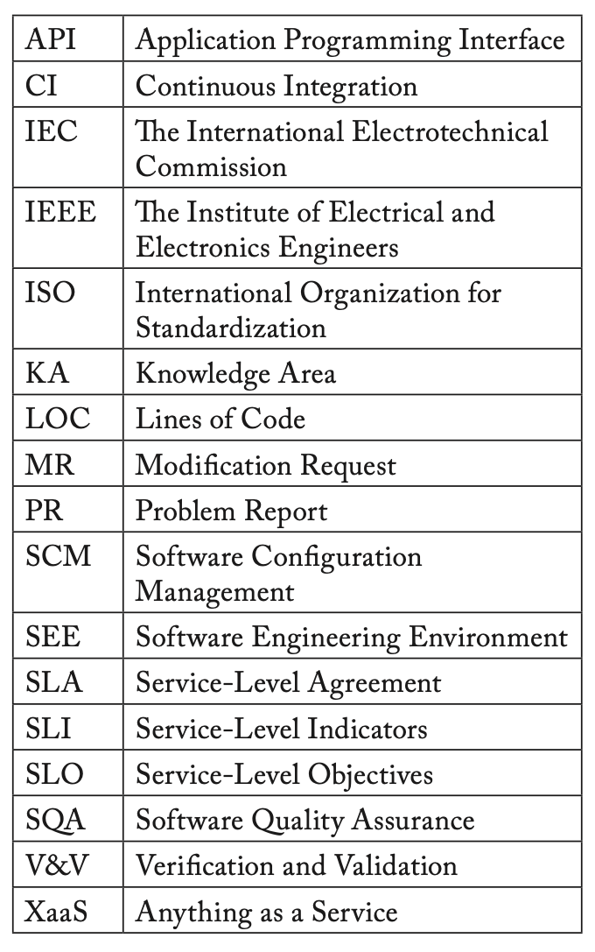
ACRONYMS

Slide 4
What is software maintenance?
Maintenance is a technical process in the life cycle of a software product.
It contains the activities and tasks of the maintenance organization.
During operation of the software, problems may be detected that were not detected during verification, validation and acceptance. Therefore, a maintenance effort is needed to cope with these problems.
Needed when upgrading system components.
The maintenance phase usually lasts until the software is retired by the disposal process

Slide 5
Need for Software Maintenance
Correct faults and latent defects
Improve the design or performance of operational software
Implement enhancements
Help users understand the software’s functionality
Adapt to changes in interfaced systems or infrastructure
Prevent security threats
Remediate technical obsolescence of system or software elements
Retire the software

Slide 6
Maintenance Costs
Operating environment (hardware and software).
Organizational environment (policies, competition, process, product and personnel).

Slide 7
Evolution of Software
Continuing Change
Increasing Complexity
Self-Regulation
Invariant Work Rate
Conservation of Familiarity
Continuing Growth
Declining Quality
Feedback System

Slide 8
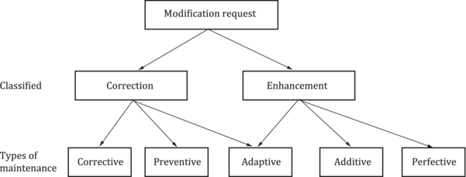
Modification Request

Slide 9
Acitvity
Instruction:
Choose one real software system that you personally use every day (for example: WhatsApp, Shopee, Maybank2u, Grab, Facebook, Instagram, Google Maps).
Search online / observe app update notes / reflect from your experience and identify at least three recent changes or updates that happened to that system.
For each change, classify the type of maintenance:
Deliverable:
Create a simple table summarising your findings.
Change / Update | Type of Maintenance | Why you classify it as that type?
e.g., fixing login error | Corrective maintenance | System failed to login → bug fix

Slide 10
Categories of Software Maintenance
Five categories (types) of software maintenance have been standardized to classify a maintenance request: corrective, preventive, adaptive, additive and perfective.
ISO/IEC/IEEE 14764 [1] also defines a sixth category — emergency maintenance.

Slide 11
Key Issues in Software Maintenance
Technical issues
  Limited understanding, testing, impact analysis, maintainability
Management issues
  Alignment with Organizational Objectives, staffing, process, supplier management, Organizational Aspects of Maintenance
Software maintenance costs
  Technical Debt Cost Estimation, Maintenance Cost Estimation,
Software maintenance measurement

Slide 12
Software Maintenance Processes
Prepare for maintenance
Perform maintenance
Perform logistics support
Manage results of maintenance and logistics

Slide 13
Processes, activities and practices that are specialized to software maintenance
Program understanding
Transition
MR acceptance/rejection
Maintenance help desk
Impact analysis
Maintenance service-level indicators (SLIs), service-level objectives (SLOs), SLAs, and maintenance software and hardware licenses and contracts

Slide 14
Planning
Business planning (organizational level)
Maintenance planning (transition level)
Release/version planning (software level)
MR planning (at individual request level).
  Collect the dates of availability of individual requests.
  Agree with users on the content of sub- sequent releases/versions.
  Identify potential conflicts and develop alternatives.
  Assess the risk of a given release and develop a back-out plan in case problems arise
  Inform all stakeholders.

Slide 15
Software Maintenance Techniques
Program Comprehension
Software Reengineering
Reverse Engineering
Continuous Integration, Delivery, Testing and Deployment
Visualizing Maintenance

Slide 16
Software Maintenance Tools
Configuration management, code versioning and code review tools
software testing tools
software quality assessment tools
Program slicers
Static analyzers
Dynamic analyzers
Data flow analyzers
Cross-referencers
Dependency analyzers
Remote Access tools

Slide 17
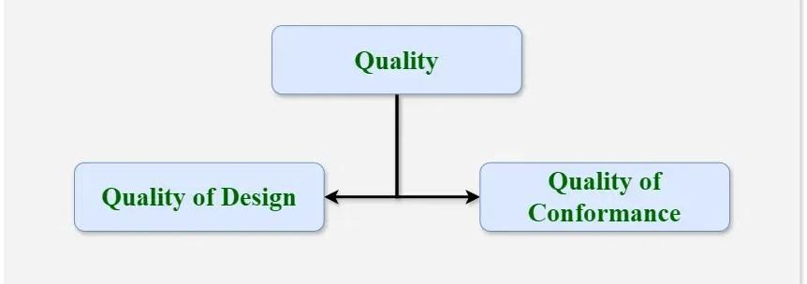
Software Quality Assurance
A set of activities that ensure processes, procedures as well as standards are suitable for the project and implemented correctly.
It focuses on improving the process of development of software - problems can be prevented before they become major issues.
The quality of the software is verified by third-party organizations - ISO Standards in Software Engineering

Slide 18
Elements of Software Quality Assurance
Standards
Reviews and audits
Testing
Error/defect collection and analysis
Change management
Education
Security management
Safety
Risk management

Slide 19
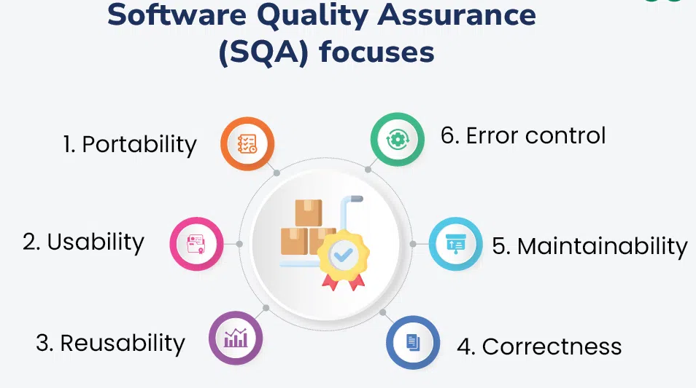
Focus of Software Quality Assurance

Slide 20
Major Activities in Software Quality Assurance
SQA Management Plan
Set The Check Points
Measure Change Impact
Multi testing Strategy
Manage Good Relations
Maintaining records and reports
Reviews software engineering activities
Formalize deviation handling

Slide 21
References
Sommerville, I. (2016). Software engineering. Pearson.
https://www.iso.org/obp/ui/en/#iso:std:iso-iec-ieee:14764:ed-3:v1:en
Guide to the Software Engineering Body of Knowledge
https://www.geeksforgeeks.org/software-testing/software-engineering-software-quality-assurance/

